Slide 1
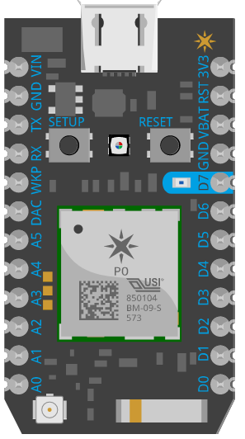
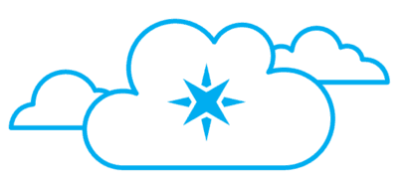



IoT Lab system architecture
3
6
1
5
2
Particle photon
Particle cloud
Azure IoT Hub
Azure
Stream analytics
Power BI
4
Lab Steps:
Connect your Particle photon to Particle cloud via wifi network
Provision Iot Hub on Azure and integrate with Particle cloud
Wire up your Photon with Photoresistor and LED
Send light levels telemetry from Photon to cloud
Create Azure Stream Analytics job
Create Power BI report and dashboard

